Slide 1

Airbnb Investment
Tool in London
Presented by
July 2025
Burak Erguner

Slide 2

Content
Introduction
Machine Learning
Data Sources and Structure
Demo
Exploratory Data Analysis (EDA)
Conclusion
Performance Metrics (KPIs)

Slide 3
Introduction
Airbnb London Challenge
Real Estate investment in London can be very expensive and overwhelming. London is one of the most demanded city in globe for real estate investments, inclusively Airbnb investors. Although, Airnbn nightly rates can be driven by several factors like seasonality, locations, amenities, beds, etc. There could be some guidelines for return-of-investment based on historical data, and investors can follow the help from our platform.
Would your investment for Airbnb in London would be profitable at what ROI ?

Slide 4
Data Overview
Data Sources and structures
Python Environment
London City
Average real-estate price in 2024 is used for calculations
Flask App
Render Environment
ML Model
ML model is trained based on XGBoost
Front-End HTML
User inputs are run over the model
Cleaned
Data Frame
Trained Model
Price & ROI Output
Airbnb Platform
Last one-year data is used as for the basis of the project

Slide 5
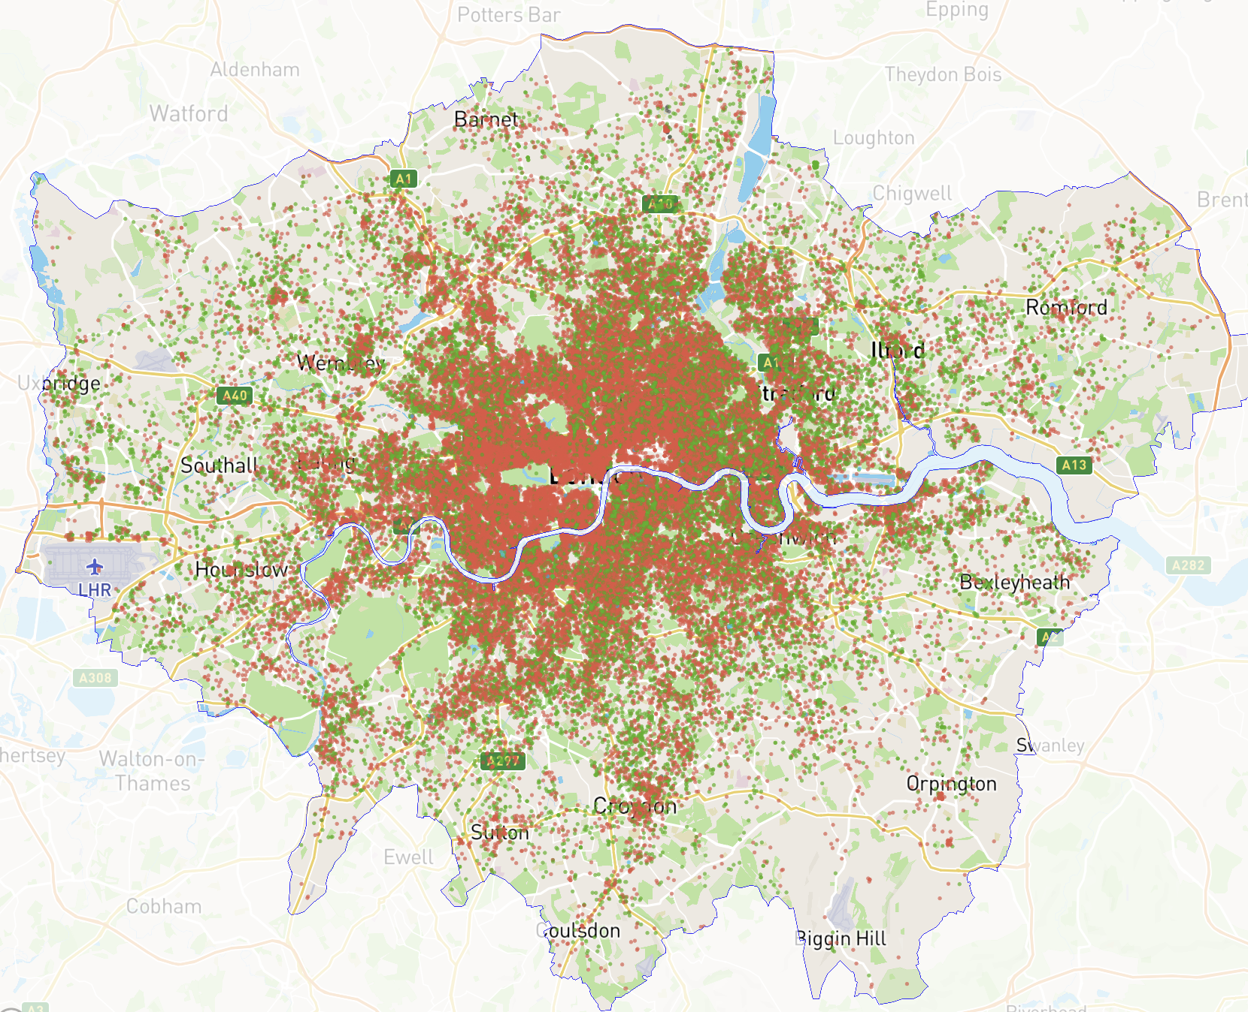
EDA & KPIs
Majority of the listings are located in Central London →
Entire home/apt listings
represents 65% of total
Average price per night
Entire Home
is observed at 138 £
Private Room
Average annual income
is total revenue of 7,175 £

Slide 6
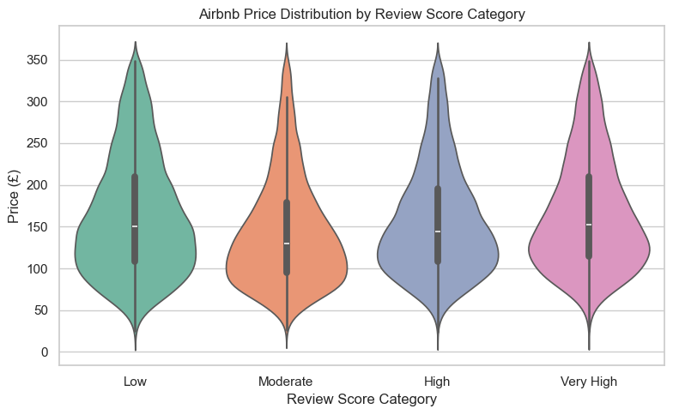
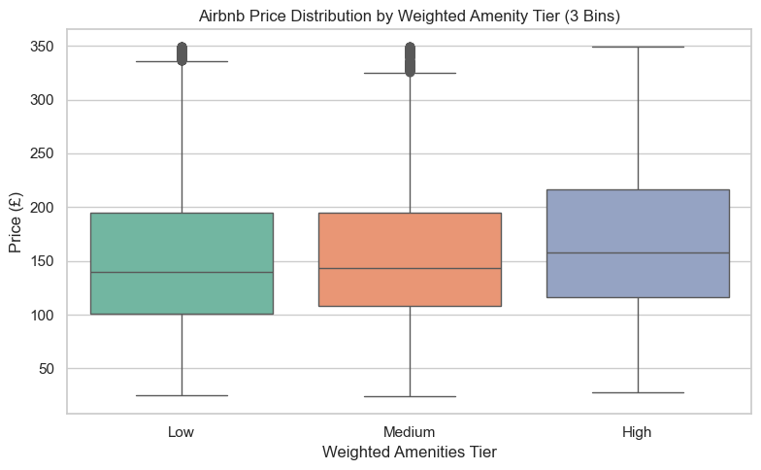
EDA & KPIs
Surprisingly, Review Scores and Amenities have zero-to-little impact on price/night →
Review scores
have no direct correlation with price/night
Amenities
have some impact on price/night

Slide 7
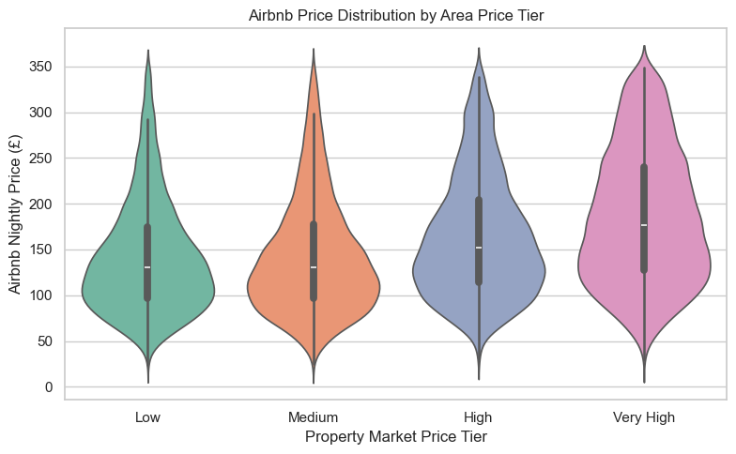
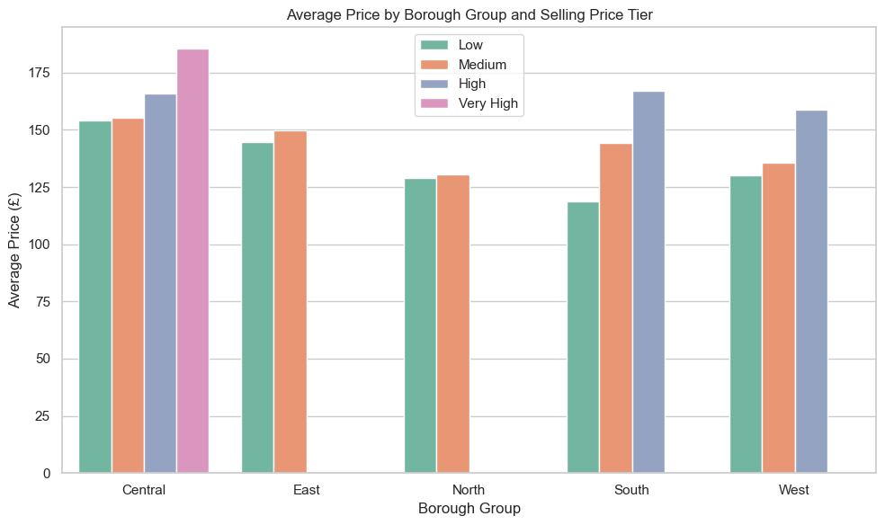
EDA & KPIs
However, Location is the main driver of the nightly rates with relation to the property selling prices→
Avg Selling Price of Property
Highly impacts nightly rates with higher end listings.
Location is the premium feature of the high nightly rates
However, low and medium selling prices of properties are generating very similar revenues.

Slide 8
ML Model Training
Predictions of Airbnb nightly prices solely driven by locations under unintentional customer choices and seasonality
Mean Absolute Error (MAE): 45 £
The price variance is around 45 £ for nightly average price prediction.
R2-score (0.30)
Although the model seem to be low in prediction power, Airbnb prices are mainly influenced by location and availability of properties based on seasonality.

Slide 9
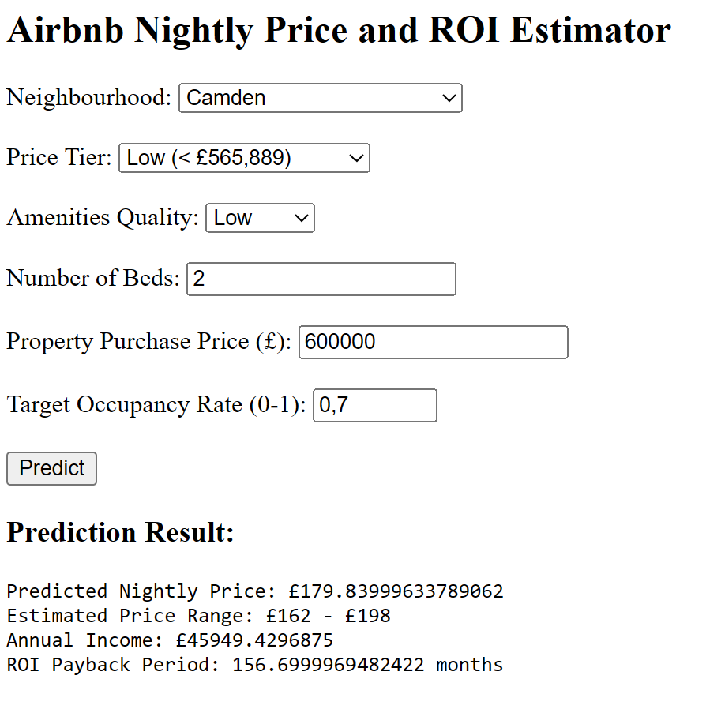
Conclusion
Airbnb Price & ROI Predictor
Airbnb Price & ROI Predictor Tool guide investors via financial aspects
Business Takeaway
This tool is to provide predicted nightly price, estimated range of nightly price, annual income and ROI payback period.
By its nature, location and property purchase price will drive the ROI.
This tool generates gross revenues; any incurring costs and taxes are not included.

Slide 10

Thank you
For your attention

